Slide 1
Analysis for poster

Slide 2
Data scraping and assumptions
Votations : classify by thematic categories
Demographics:
average for the data between 2011-2014, some only 1 or 2 years.
Crude number (Married, divorced, male, female…) were turned into percentage
→cite some demographics? Say exhaustive list is on github

Slide 3
Analysis of political parties
Recommendations of Each party for each of the 42 votations:
42 features, 11 parties
K-means clustering
Manual clustering
Same results

Slide 4
Analysis of political parties
Keep only the parties that have an important weight (% of vote received for the nation)
Right: UDC, PBD, PLR, PVL, PDC
Left: PEV, PES, PS
Total: 95 of votes at national council
Weight their recommendation by the % of votes they received at national election
Compute main recommendation for right and left (yes or no)
LIMITATIONS: parties don’t always agree in each group (expl UDC often advises something different than the rest of the right). Also visible on the Clustering
 | Party | Group | Vote at national council 2015
PLR | Parti Libéral Radical | Right | 16.4%
PDC | Parti Démocratique Chrétien | Right | 11.6%
PS | Parti Socialiste | Left | 18.8%
UDC | Union Démocratique du Centre | Right | 29.4%
PEV | Parti Evangélique | Left | 2.1%
PCS | Parti Chrétien Social | Left | N/A
PVL | Parti Vert'libéraux | Right | 4.6%
PBD | Parti Bourgeois Démocratique | Right | 4.1%
PST | Parti du Travail | Left | 0.9%
PES | Parti Ecologiste | Left | 7.1%
DS | Démocrate Suisse | Left | N/A
UDF | Union Démocratique Fédérale | Right | N/A
Lega | Ligue des Tessinois | Right | N/A
MCR | Mouvement Citoyens Romand | Right | N/A

Slide 5
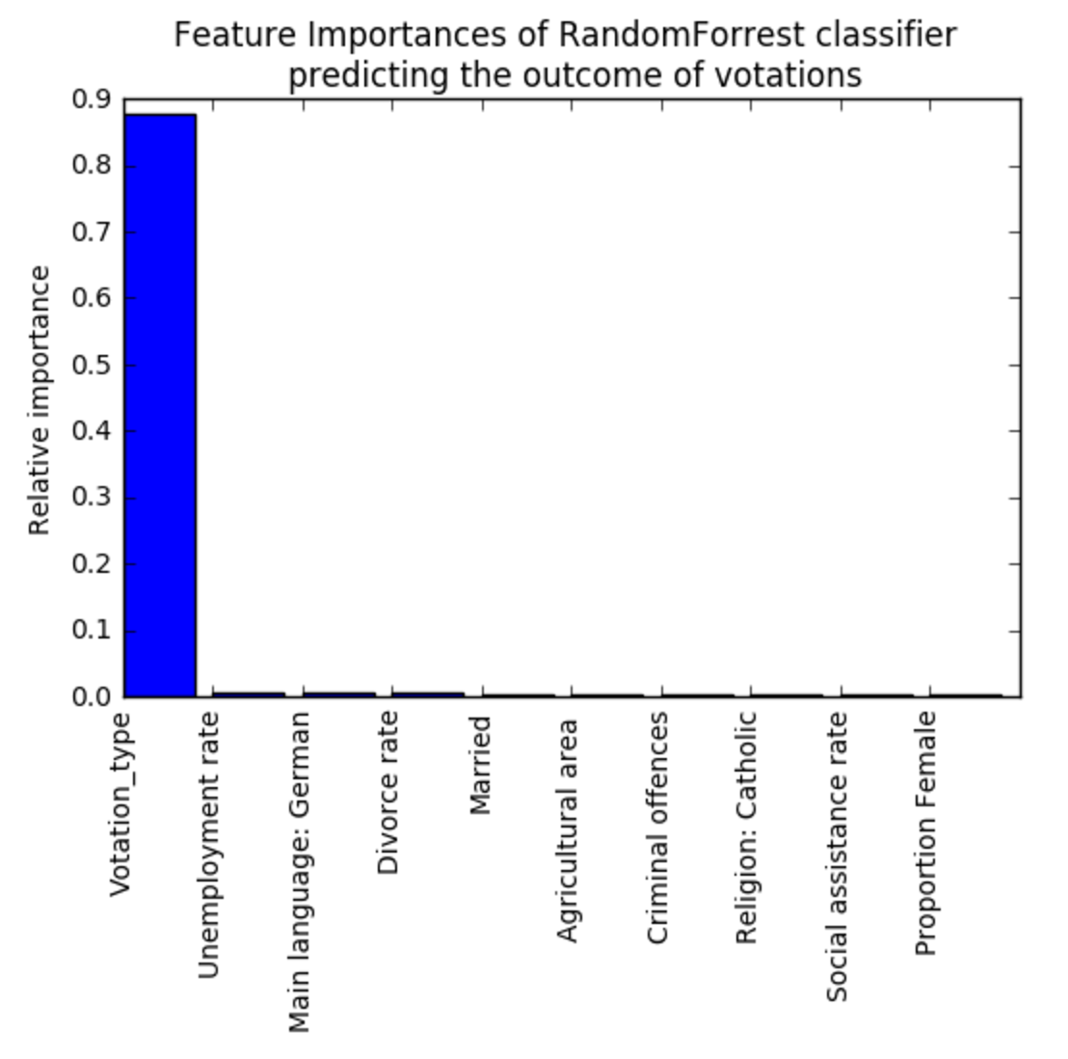
Analysis of votations outcome
Raw outcome = % oui and % no
Compare winning answer (yes or no) with recommendation of left and right groups
4 possible outcome of votations: Right won, left won, both won, none won (won=had their recommendation followed)
Predict the Outcome based on demograhics and votation type: RandomForrest classifier 20 trees, 10_fold cross validation
Accuracy of 44% for 4 class
Votation type only important parameter
Too much correlation between sample

Slide 6
Analysis of votations outcome per votation type
Average the votation outcome by votation type
→ Compute a score for each canton and each votation category:
Score = (right victories - left victories)/nb votations
Scores from -1 to +1 reflect the victories of both groups
Negative scores: the left won more often
Positive scores: the right won more often

Slide 7
Analysis of votations outcome per votation type
 | All votations | Economy | Education | Environment | Immigration | Health | Security | Social | Work
ZH | 0.07 | 0.25 | 0.33 | -0.22 | 0.33 | 0.29 | 0 | -0.43 | 0.6
BE | 0.17 | 0.25 | 0.33 | -0.22 | 0.33 | 0.29 | 0.5 | -0.14 | 0.6
LU | 0.26 | 0.25 | 0.33 | 0 | 0.33 | 0.29 | 1 | -0.14 | 0.6
UR | 0.21 | 0.25 | 0.33 | 0 | 0.33 | 0.29 | 1 | -0.14 | 0.2
SZ | 0.26 | 0.25 | 0.33 | 0 | 0.33 | 0.29 | 1 | -0.14 | 0.6
OW | 0.26 | 0.25 | 0.33 | 0 | 0.33 | 0.29 | 1 | -0.14 | 0.6
NW | 0.26 | 0.25 | 0.33 | 0 | 0.33 | 0.29 | 1 | -0.14 | 0.6
GL | 0.26 | 0.25 | 0.33 | 0 | 0.33 | 0.29 | 1 | -0.14 | 0.6
ZG | 0.26 | 0.25 | 0.33 | 0 | 0.33 | 0.29 | 1 | -0.14 | 0.6
FR | -0.02 | 0.25 | -0.33 | -0.44 | 0.33 | 0.29 | 0.5 | -0.43 | 0.2
SO | 0.17 | 0.25 | 0.33 | -0.22 | 0.33 | 0.29 | 1 | -0.43 | 0.6
BS | 0.02 | 0.25 | 0.33 | -0.44 | 0.33 | 0.29 | 0 | -0.43 | 0.6
BL | 0.17 | 0.25 | 0.33 | 0 | 0.33 | 0.29 | 0.5 | -0.43 | 0.6
SH | 0.12 | -0.25 | 0.33 | -0.22 | 0.33 | 0.29 | 0.5 | -0.14 | 0.6
AR | 0.21 | 0.25 | 0.33 | -0.22 | 0.33 | 0.29 | 1 | -0.14 | 0.6
AI | 0.26 | 0.25 | 0.33 | 0 | 0.33 | 0.29 | 1 | -0.14 | 0.6
SG | 0.21 | 0.25 | 0.33 | -0.22 | 0.33 | 0.29 | 1 | -0.14 | 0.6
GR | 0.21 | 0.25 | 0.33 | -0.22 | 0.33 | 0.29 | 1 | -0.14 | 0.6
AG | 0.21 | 0.25 | 0.33 | -0.22 | 0.33 | 0.29 | 1 | -0.14 | 0.6
TG | 0.21 | 0.25 | 0.33 | -0.22 | 0.33 | 0.29 | 1 | -0.14 | 0.6
TI | 0.21 | 0.25 | 0.33 | 0.22 | 0.33 | 0.29 | 0.5 | -0.43 | 0.6
VD | -0.02 | 0.25 | -0.33 | -0.22 | 0.33 | 0 | 0 | -0.43 | 0.6
VS | 0.17 | 0.25 | -0.33 | 0.44 | 0.33 | 0.29 | 0.5 | -0.43 | 0.2
NE | -0.12 | 0.25 | -0.33 | -0.44 | 0.33 | 0 | 0 | -0.43 | 0.2
GE | -0.07 | 0.25 | -0.33 | -0.22 | 0.33 | -0.29 | 0 | -0.43 | 0.6
JU | -0.12 | 0.25 | -0.33 | -0.44 | 0.33 | 0 | 0 | -0.43 | 0.2

Slide 8
Clustering of cantons based on their political sensibility for each category
Features: scores for each votation type
PCA ( 4 components explain 95% variance)
K-means: 5 clusters

Slide 9
Correlations between demographics and score
Cross correlations to find the features that correlate with the scores
For the score for all votations:

Slide 10
Correlations between demographics and score
Demographic parameters | p-value | Correlation coefficient
Utilised agricultural area per farm in ha | 4.73E-09 | -0.88
Main language French | 6.55E-08 | -0.84
Unemployment rate | 2.77E-07 | -0.82
Social assistance rate | 6.61E-06 | -0.76
Crude divorce rate | 1.37E-05 | -0.74
Criminal offences under the Swiss Criminal Code | 6.49E-05 | -0.70
Proportion female | 2.33E-04 | -0.66
Religious affiliation: No affiliation | 1.25E-03 | -0.60
Divorced | 1.39E-03 | -0.59
Criminal offences under the Narcotics Act | 1.74E-03 | -0.58
Criminal offences under the Foreign Nationals Act | 2.45E-03 | -0.57
Education expense (per habitant) | 7.45E-03 | -0.51
Net activity rate (15-64 years) | 6.54E-03 | 0.52
Married | 1.60E-03 | 0.59
Average per capita living space | 5.66E-04 | 0.63
Upper secondary education (aged 25 or over) | 3.62E-05 | 0.72
Main language German | 5.81E-06 | 0.76
Features that significantly correlated with the scores for all votations (pvalue <0.01)

Slide 11
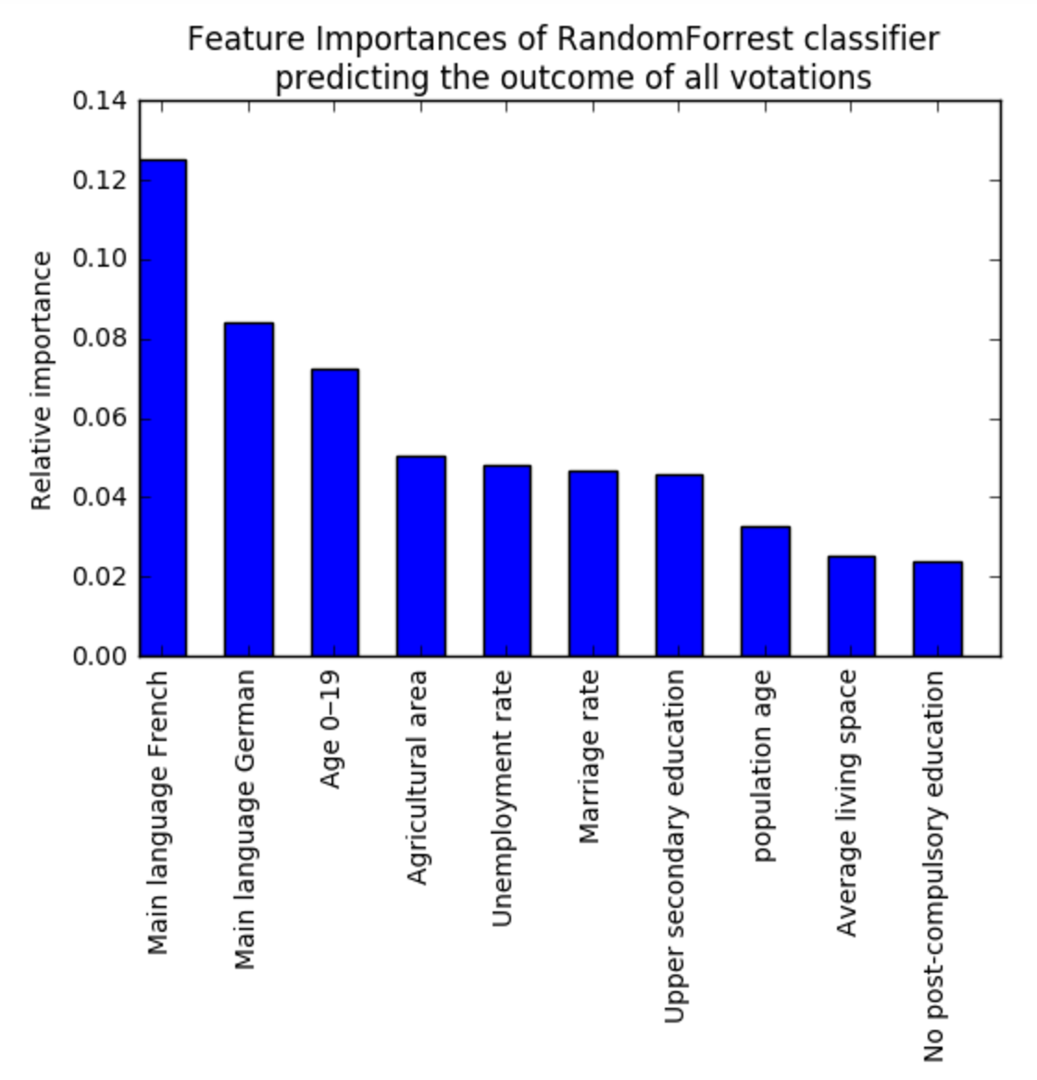
Predicting the outcome of the votations for each type
Random forrest 100 trees 10 fold cross validation
Label to predict is the boolean score (1 or 2 for right and left) for each votation category
Allows to visualise the feature importance for eahc category (one classifier per catgeory)
LIMITATION: trained and tested on the boolean averaged outcome: in reality even if there is a 1 for this score it doesn’t mean that this canton voted for the right all the time: PAS SURE QUIL FAILLE LE METTRE!!

